Slide 1
SAN FRANCISCO CRIME ANALYSIS
ASHOKKUMAR SHARMA
EASHANI DEORUKHKAR
HAMZA MIGHRI
SHIVANI KULKARNI

Slide 2
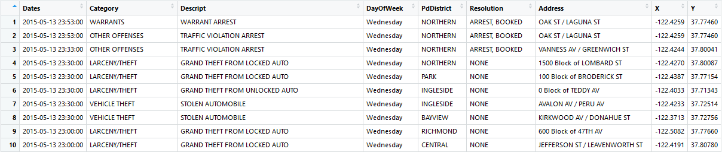
DATA Exploration
Source: https://www.kaggle.com/c/sf-crime/data
Dataset provides 12 years of crime data of San Francisco’s neighborhood
Train Data – Even Weeks
Test Data – Odd Weeks

Slide 3
Data Fields
Dates - timestamp of the crime incident
Category - category of the crime incident (only in train.csv).
Descript - detailed description of the crime incident (only in train.csv)
DayOfWeek - the day of the week
PdDistrict - name of the Police Department District
Resolution - how the crime incident was resolved (only in train.csv)
Address - the approximate street address of the crime incident
X - Longitude
Y - Latitude

Slide 4
Data pre-processing
The “Dates” column was split into the fields date, hour
Based on the “DayOfWeek” field, another field “iswkend” was generated as a dummy variable that described whether the day was on a weekend
New fields:
- Date
- Hour
- Iswkend

Slide 5
BUSINESS QUESTIONS
Which districts have the highest crime rate so that action could be taken in those locations?
On what days is the crime rate high?
Which crime has the most number of unresolved cases?

Slide 6
Exploratory data analysis

Slide 7
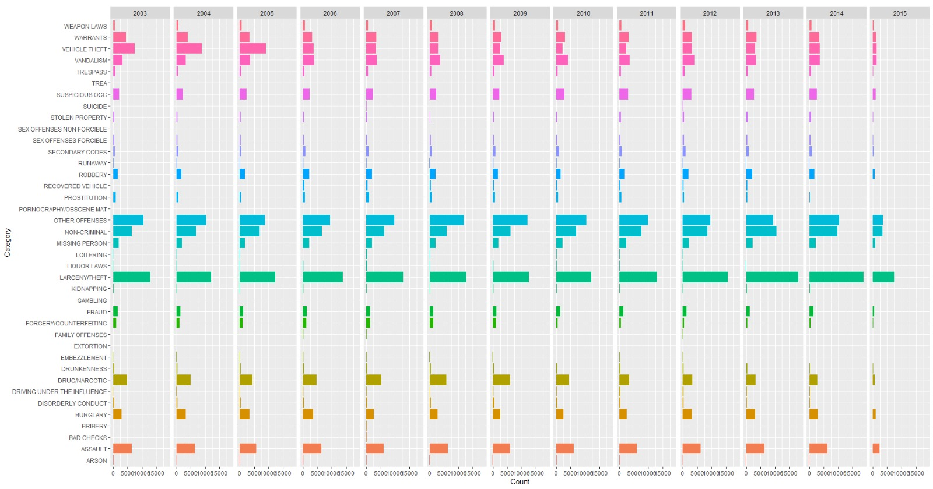

Slide 8
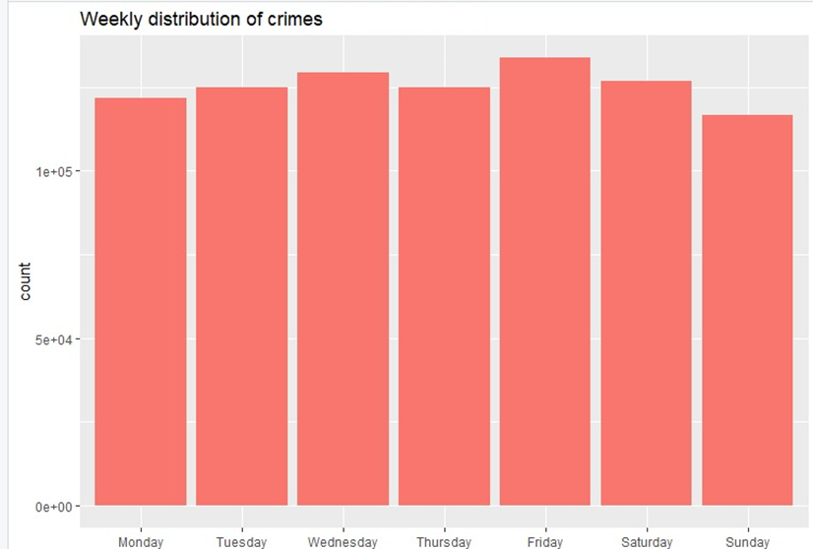
Crimes by day

Slide 9
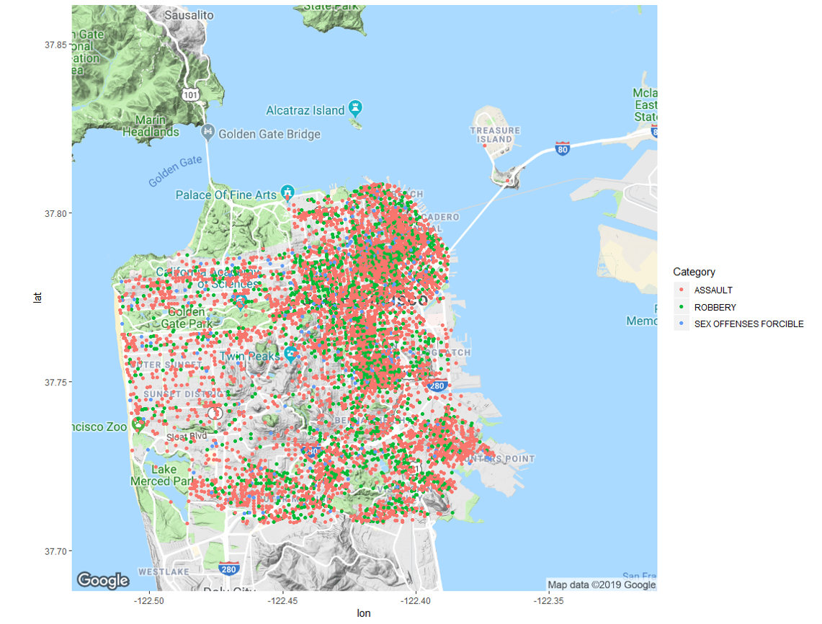
Violent crimes mapped

Slide 10
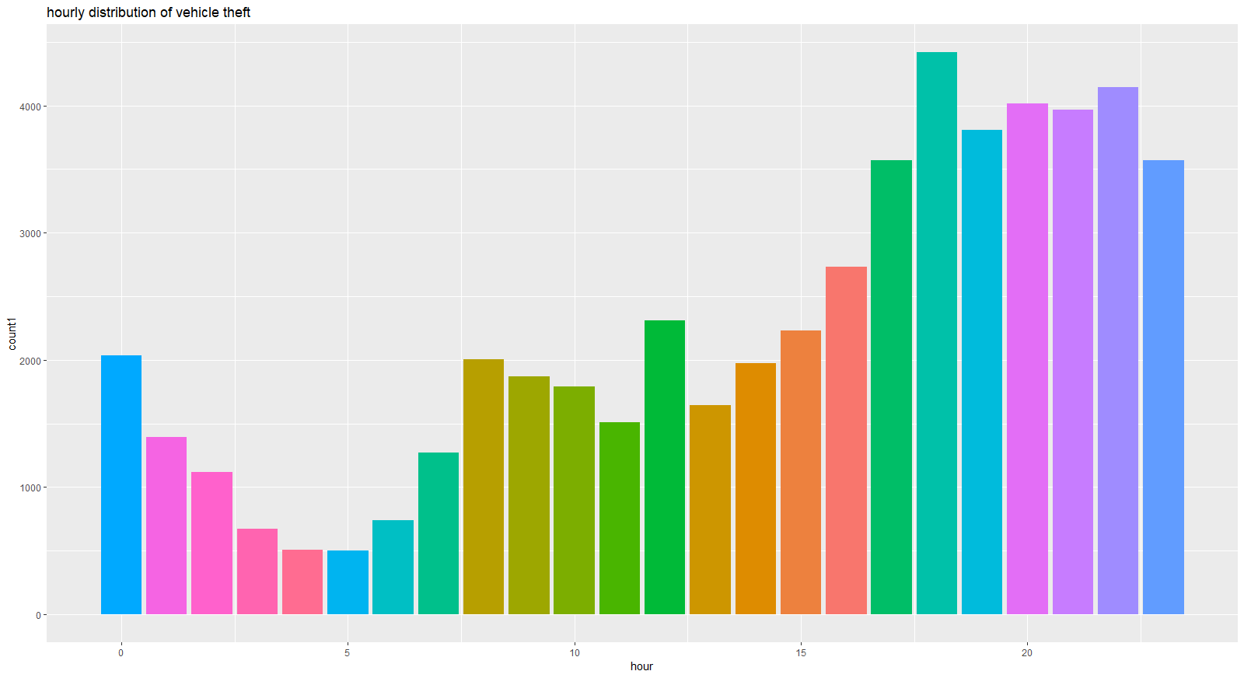
Vehicle theft by hour

Slide 11
Data modelling

Slide 12
Models
Association Rule Mining
K Nearest Neighbors
Random Forests
Naïve Bayes Classifier

Slide 13
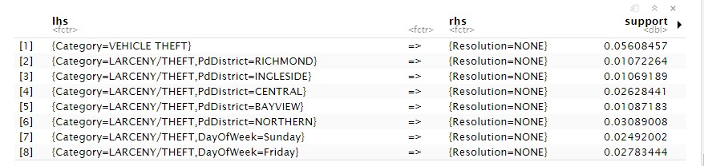
Association rule mining
STRONG RULES

Slide 14
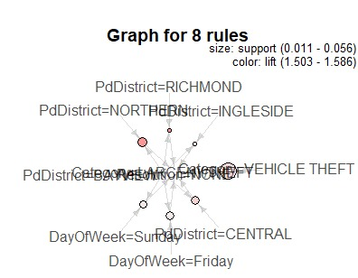
Rules visualization

Slide 15
Performance measure: log loss
ACCURACY:
Predicted Value = Actual Value
Log Loss:
Uncertainty on how much Predicted Value varies from Actual Value
-1 * Log(Likelihood Function)
Lower Log Loss value -> Better Predictions
Kaggle Requirement

Slide 16
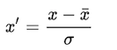
K NEAREST NEIGHBORS
Z-SCORING
Euclidean distance
Hour ranges from 1 – 24
Longitude & Latitude have a vast range
Standardising using Mean & Standard Deviation
Formula:

Slide 17
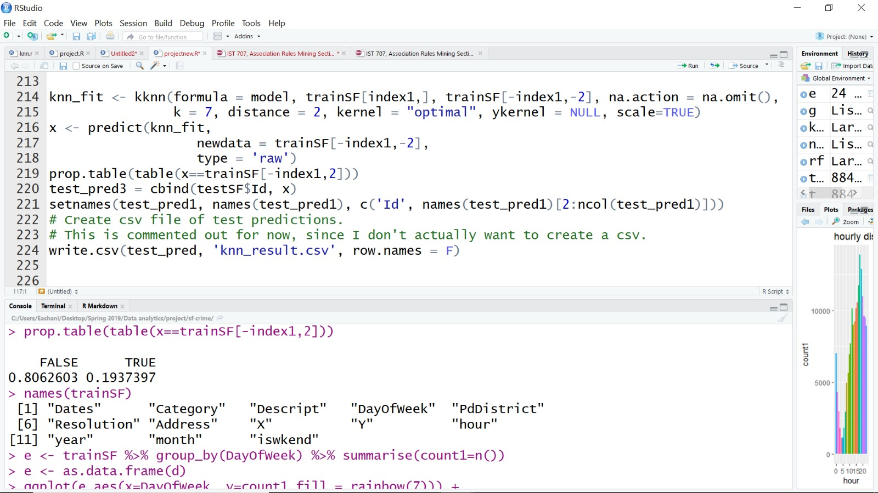
KNN Model:
Kaggle Score:

Slide 18
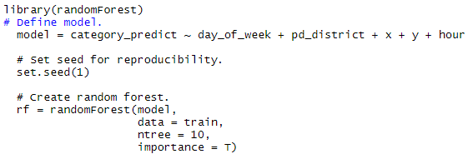
RANDOM FORESTS
Without Tuning:
Kaggle Score:

Slide 19
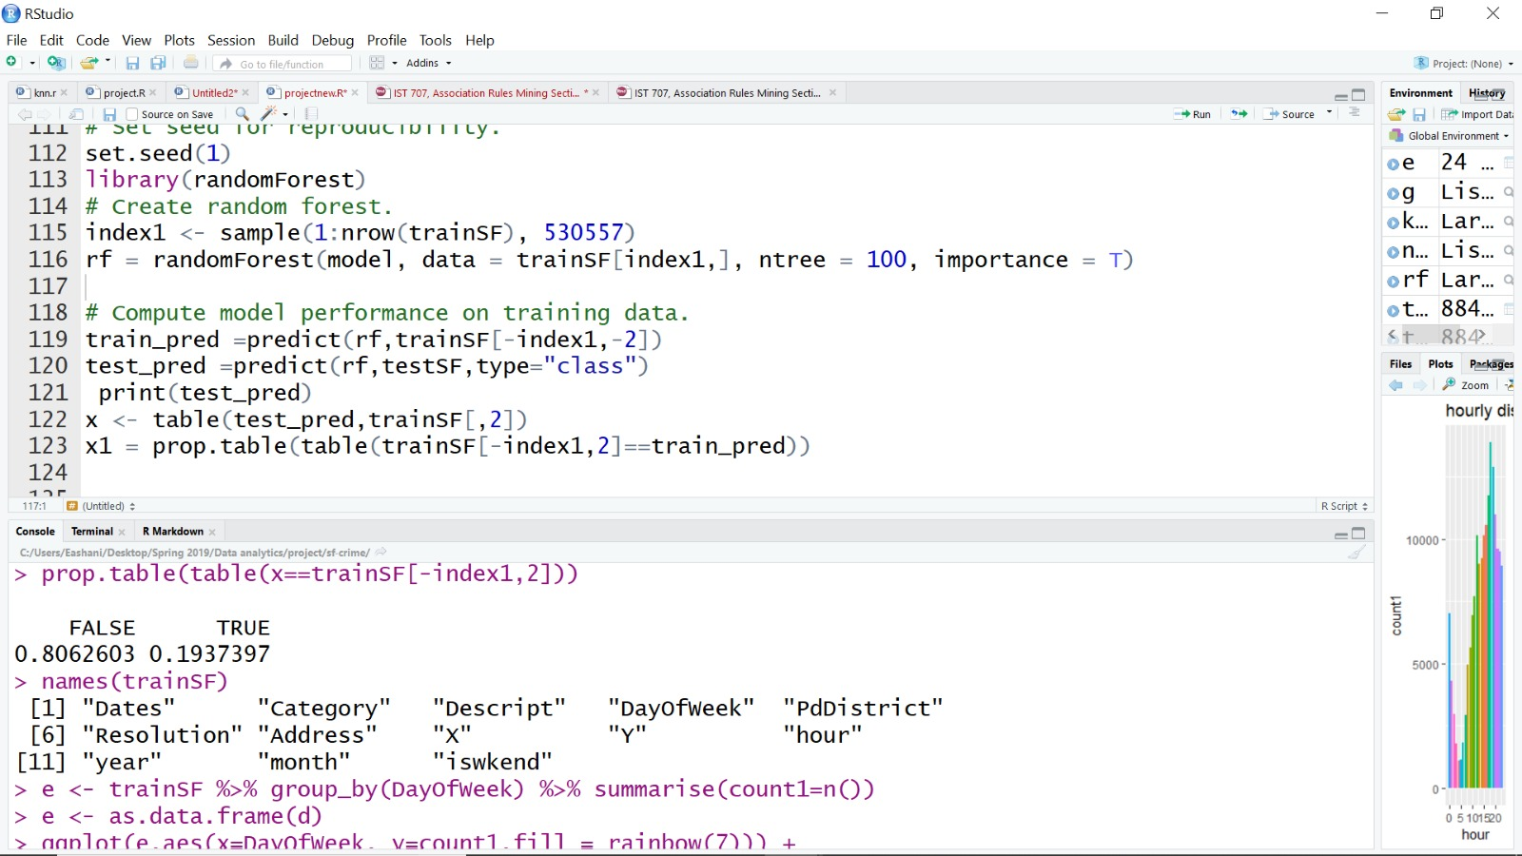
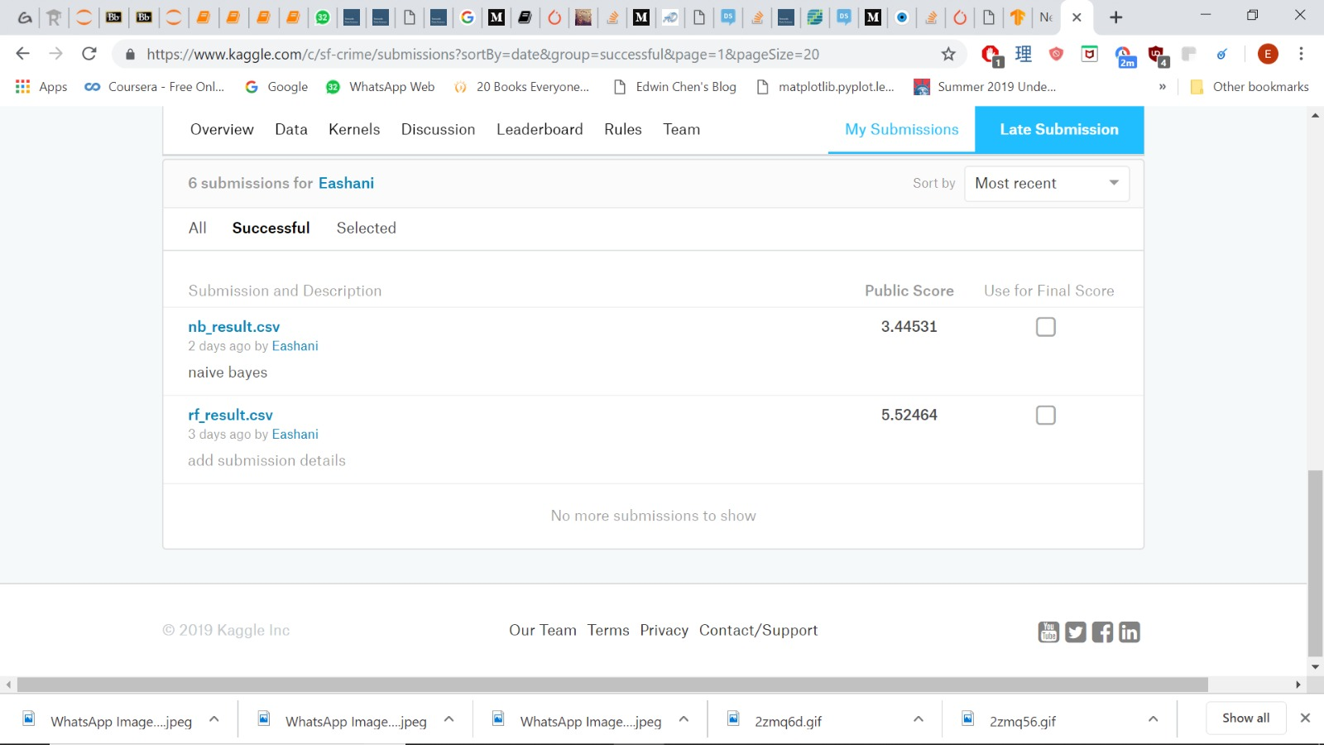
RANDOM FORESTS
With Tuning:
Kaggle Score:

Slide 20
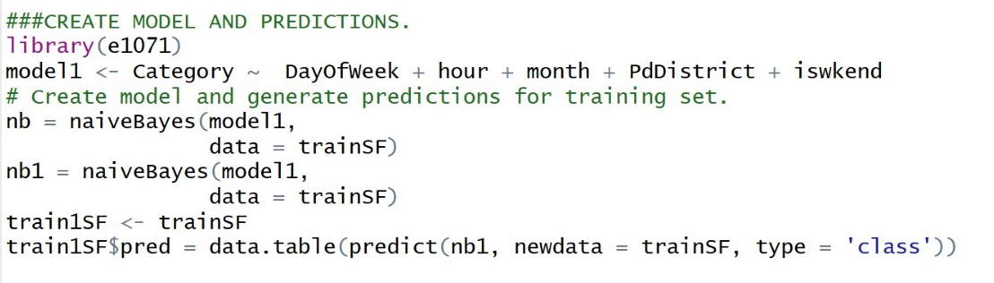
NAÏVE BAYES CLASSIFIER
Without Tuning:

Slide 21
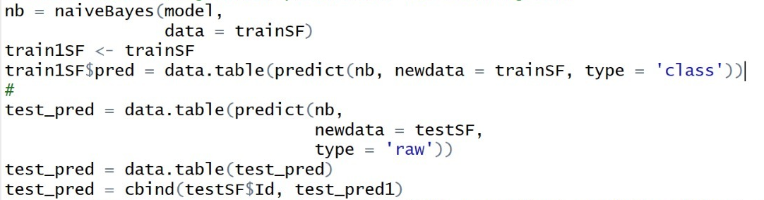
NAÏVE BAYES CLASSIFIER
Without Tuning:
Kaggle Score:

Slide 22
Insights
More efforts need to be deployed in districts of: RICHMOND/ INGLESIDE/ CENTRAL/ BAYVIEW/ NORTHERN
Deploy more security and police officers during the weekend, as crimes of all sort peak on Friday and Sunday
Since most unresolved crimes are related to vehicle theft, the various districts ought to increase surveillance in public areas through investment in technological tools.

Slide 23
THANK YOU

